Slide 1
Syringe Access Programs Engagement Models and Interventions
Notes:
TRAINER INSTRUCTIONS
Welcome!
This is a half-day overview on Syringe Access Programs: Models and Interventions with a focus on People Who Inject Drugs (PWID)
The workshop is 3 hours with one scheduled 15 min break.
NOTES
Include Introductions if this workshop does not follow another HHRN training that already had an Introductions section.
Introductions are when each workshop participant can share their name and program or agency they work with.

Slide 2
HIV Harm Reduction Navigator Training
Commissioned by NYC DOH National Capacity Building Program for Health Departments and CBOs who have outreach staff and peers providing prevention services for people who use drugs.
Particular focus on PWID and health care issues.
Materials are drawn from HRC’s long experience and other Harm Reduction program peer training programs.
You are experts in the field no matter how long you have been doing outreach. Everyone brings relevant experiences & perspectives to this work.
Notes:
TRAINER INSTRUCTIONS
The HIV Harm Reduction Navigator Training series was commissioned by NYC DOH National Capacity Building Program for Health Departments for CBOs who have outreach staff and peers providing prevention services for people who use drugs, with a particular focus on PWID and health care issues.
Life or Lived experience is valuable and HHRN workers are already experts in their own field, regardless how long they have been an official Peer or Outreach Worker.
This training will bring participants up to speed with current, evidence-based interventions and language that will be useful out in the field.
NYCDOH: New York City Department of Health
CBO: Community Based Organizations

Slide 3
1. Workshop Overview
Notes:
KEY MESSAGES
Purpose of Training
This workshop will explore the need for syringe access programs (SAPs) from a public health perspective.
By examining various functions and interventions of program models in the United States, we will discuss syringe access in the context of an engagement model and intervention for people who use drugs.
Including the benefits beyond providing safer injection materials, and applies ‘best practice’ service provisions adaptable to various SAP settings, models, and client engagement settings.
NOTES
Providing information on the current public health impact of injection drug use in your community, and legal issues around syringe distribution, paraphernalia laws, and other local regulations in your state, will provide relevant context.
This will also allow participants to gain vital knowledge while preparing for their roles as HHRNs. We encourage trainers to incorporate as much regional and state-specific examples and trends as possible in HIV/Hep C/Overdose rates and drug use behaviors (e.g. commonly used drugs in the region, routes of administration, syringe access issues, etc.).

Slide 4
Group Agreements
Step up, Step Back
Non-Judgment
Use “I” Statements
Agree to disagree
Confidentiality
WAIT/PUSH/ELMO
Notes:
TRAINERS INSTRUCTIONS
We are talking about syringe access programs today, so this workshop might bring up sensitive topics for some workshop participants.
Nobody is expected to talk about their own experiences with injection drug use.
Use the training to ask questions and discuss concerns.
It will be important to be respectful of each other during this time.
Are there other group agreements to add? (ex: cell phone or technical device use, one mic, etc.)
KEY MESSAGES
Step Up/Step Back:
Agree to Disagree: We all have own opinions.
WAIT: Why Am I Talking
PUSH or ELMO: Say PUSH, to “push” on training or Everybody Lets Move On

Slide 5
Training Objectives
By the end of this session you will be able to:
Describe the need for syringe access programs with an evidence-based perspective.
Examine local and national SAPs within the context of harm reduction.
Discuss the benefits of SAPs and serving people who inject drugs.
Recall programmatic qualities of various SAP models.
Notes:
TRAINER INSTRUCTIONS
This is a half-day workshop with one scheduled break.
Workshop includes discussion and activities.
By the end of this session you will be able to:
Describe the need for syringe access programs with an evidence-based perspective.
Examine local and national SAPs within the context of harm reduction.
Discuss the benefits of SAPs and serving people who inject drugs.
Recall programmatic qualities of various SAP models.

Slide 6
Agenda
Syringe Access Programs
1 | Workshop Overview
2 | Harm Reduction & Syringe Access
3 | Benefits of SAPs
 | Break
4 | Activity!
5 | Syringe Access Models & Interventions
6 | Closing & Evaluations
Notes:
TRAINER INSTRUCTIONS
Brief review to let participants know what to expect for the next three hours.

Slide 7
Glossary
PWID—People Who Inject Drugs
PWUD—People Who Use Drugs
PLWHA—People Living with HIV/AIDS
SUDs—Substance Use Disorders
SAS – Syringe Access Services
SEP – Syringe Exchange Program
AOD – Alcohol & Other Drugs
Notes:
TRAINER INSTRUCTIONS
Briefly review acronyms
What other terms are there?
HHRN – HIV Harm Reduction Navigators
SAP – Syringe Access Programs
IDU – Injection Drug User*
*This is what they used to call PWID, note how language is fluid and always changing.

Slide 8
Sexual Orientation >>
to whom we are sexually attracted
Gender Identity >>
sense of self as male or female, neither or both
LGBTQI
Lesbian, Gay, Bisexual, Transgender, Transsexual, Two Spirited, Questioning, Intersex
Notes:
KEY MESSAGES
Language is fluid and definitions or self-identification adjectives change with time and context.
Recognizing the distinction of Sexual Orientation from Gender Identity will be useful when developing relationships in this work.
Sexual Orientation: to whom we are sexually attracted
Gender Identity: sense of self as male or female, neither or both
Intersex: a person whose biological anatomy and/or genes vary from the expected male or female anatomy and/or genetics
LGBTQQIAA2SP: Lesbian, Gay, Bisexual, Transgender, Queer, Questioning, Intersex, Ally, Asexual, Two-Spirit, Pansexual
Examples:
My sexual orientation is I’m Gay, my gender identity is Male
My sexual orientation is Bisexual, my gender identity is Trans Female
8

Slide 9
BRAINSTORM: What is Syringe Access?
Notes:
ASK
What is Syringe Access? What does that mean?
When you hear it, what comes to mind in terms of services?
TRAINER INSTRUCTIONS
Use this brainstorm as a way to open the training, getting a sense of what syringe access means to participants, including their experiences with programming.
Participant input may come from a personal perspective,
or a professional one like how syringe access is –or is not- incorporated at their agency for example,
or in relation to their experience working as a peer/service provider.
Optional
Write down responses on Newsprint w. Thick Pen Markers
Or, ask if a volunteer would write down answers while you facilitate discussion
Or, have this discussion only

Slide 10
VIDEO
“The Exchange”
End the Ban on the Use of Federal Funds for Syringe Exchange (2013)
*thank you* amfAR and waterbound pictures
Notes:
TRAINERS PREP
For the video, cut and paste You Tube link below into a web page
https://www.youtube.com/watch?v=Q0qcu3F7_BY
The Exchange (10 min)
Trainers should check the most up to date language of the ban and any local legalities around funding using state or city funds as well to give a local context.
KEY MESSAGES
This video introduces the history of, and concepts behind, syringe access programs.
The Ban on Federal funding for syringe exchange was recently lessened in January 2016 to cover only the purchase of actual syringes.
The ban on federal money being used to support syringe access was put in place 1988, lifted briefly Dec 2009 but resumed 2010, then lessened January 2016 in that no federal monies can purchase the actual syringe but can be spent on labor, for example.
According to an overwhelming body of evidence, needle and syringe services programs not only reduce the spread of HIV and other blood-borne diseases, but also save money, encourage the safe disposal of syringes, minimize the risk of needlestick injuries to law enforcement officials, and help give people who inject drugs access to vital drug treatment services.
In spite of the strong evidence in favor of these cost-effective public health programs, the use of federal funds to support syringe exchange programs has been banned during this epidemic.
NOTES
Video published on Feb 13, 2013
For more information visit amfAR, http://www.amfar.org/endtheban Directed by Naftali Beane Rutter Produced by waterbound pictures

Slide 11
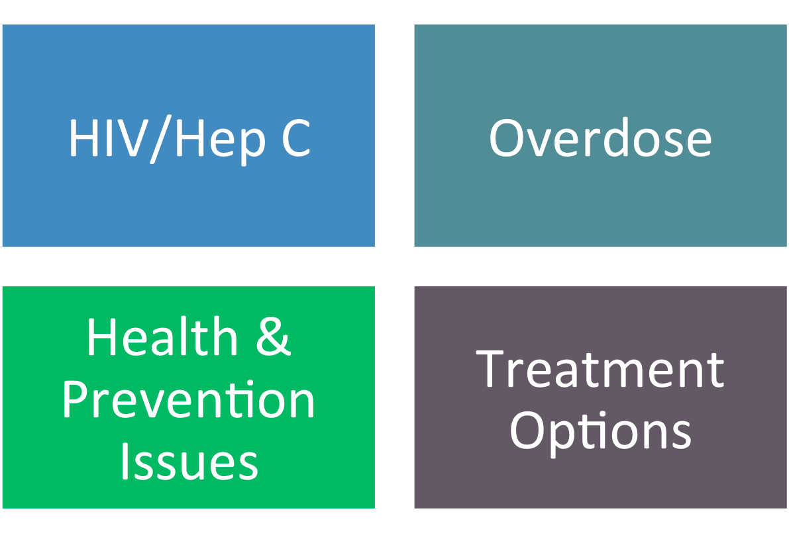
2. Harm Reduction & Syringe Access
Notes:
KEY MESSAGES
These are the key issues we are addressing as part of syringe access programming.

Slide 12
Working Definition of Harm Reduction
A set of practical, public health strategies designed to reduce the negative consequences of drug use and promote healthy individuals and communities.
Notes:
KEY MESSAGES
Define the need for prevention programs from a harm reduction perspective, contextualizing and defining public health issues for active and former drug users
Examine the national and local context for prevention programs including legal issue and trends in HIV, HCV, and OD rates.
Explore the specific benefits of syringe access programs and services from a broad public health stance, as well as from locally relevant issues in their community.
Understand the functions of different syringe access program models, including effective outreach and engagement models.
Explore how to use this information to build alliances and partnerships in their communities with other CBOs, law enforcement, and at the policy/advocacy level.
Understand basic SAP operations, including equipment needs, proper waste disposal, safety issues, and SAP practices relevant to their work as HHRNs.

Slide 13
Goals of Harm Reduction
Increased health and well-being.
Increased self-esteem and self-efficacy.
Better living situations.
Reduced isolation and stigma.
Safer drug use.
Reduced drug use and/or abstinence.

Slide 14
HIV & Hepatitis C Rates
Newly infected each year in the U.S. due to syringe and equipment sharing:
HIV: 8,000 people
Hep C: 30,000
Overdose is the leading cause of accidental death in the US.
Source: The Center for Disease Control and Prevention, AIDS United.
http://www.aidsunited.org/policy-advocacy/issues/syringe-exchange/
http://www.cdc.gov/idu/hepatitis/viral_hep_drug_use.htm
http://www.cdc.gov/HomeandRecreationalSafety/Poisoning/brief_full_page.html

Slide 15
HIV/Hep C Co-infection in the U.S.
http://www.cdc.gov
Notes:
KEY MESSAGES
Connection between HIV, Hep C and PWIDs
The majority of HIV/Hep C co-infected people are injection drug users (IDUs).
Within 5 years of beginning to inject, 50-80% of IDUs are infected with Hep C.
It is estimated that 50-90% of IDUs with HIV also have Hep C.
http://www.cdc.gov/hepatitis/Populations/PDFs/HIVandHep-FactSheet.pdf

Slide 16
HIV/Hep C Co-infection Snapshot
Because HIV affects the immune system, it can affect the body's ability to fight off Hep C.
Treatments for both can be affected if co-infected.
Some HIV meds may less effective if also w. Hep C.
Everyone's experience is different.
It’s important to discuss with your doctor what the options are and what to treat first.
http://www.cdc.gov/hepatitis/Populations/PDFs/HIVandHep-FactSheet.pdf
Notes:
KEY MESSAGES
If you are HIV-positive, getting treated for Hep C can improve your overall health, make your HIV medications more effective, and increase your HIV treatment options.
HIV can accelerate HCV disease progression
Liver damage can be more serious and can advance more quickly (ex: immune response, duration of infection).
Co-infected people w <200 CD4 cells are at greatest risk for serious liver damage.
Hep C added to the list of CDC list of AIDS-related complications in 2000.
Liver damage can make it harder to tolerate certain HIV drugs,
Which may result in hepatoxicity (damage to the liver caused by a medicine, chemical, or herbal or dietary supplement)
Tx Options
Treating HCV before starting ARV therapy can reduce risk of liver toxicity from HIV medication
Newer HCV drugs are more effective and easier to tolerate
Many wish to get HIV “under control” first with ARV medications, then move forward with HCV treatment.
Treatment options are a personal choice that need to be made in partnership with their doctor, and based on individual factors and circumstance.

Slide 17
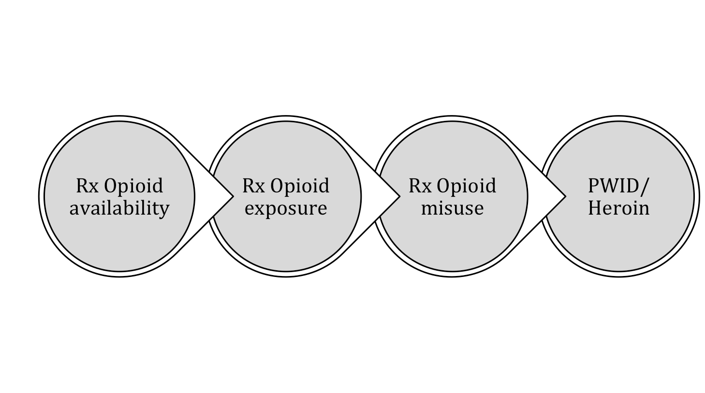
Drug Trend in the U.S. Opioid Epidemic

Slide 18
Overdose in the U.S.
Unintentional drug overdose deaths have tripled: 1999 (12,186) → 2013 (43,982)
Of 43,982 deaths, 22,767 were related to pharmaceutical overdoses in 2013.
71.3% involved opioid analgesics.
Drug overdose is now the leading cause of accidental death, now surpassing motor vehicle accidents.
Source: Centers for Disease Control and Prevention;
National Vital Statistics System mortality data . (2015)
Notes:
TRAINER INSTRUCTIONS
Use as many local statistics as possible, to make the training relevant to the geographic area you are providing this training. Local statistics can be found through state or city health department websites.
KEY MESSAGES
Opioid Overdoses are classified by medical examiners/corners as “Unintentional drug poisoning deaths”.
In a period of less then 10 years the numbers of unintentional/accidental drug poisoning DEATHS have at least tripled.
In the past, vehicle accidents were the leading cause of accidental deaths, however now overdose is.
Although overdoses from opiates are increasing, not all overdoses are fatal.
Unintentional drug overdose deaths nationwide: 1999 (12,186) → 2013 (43,982)
Of the 43,982 deaths in 2013, 22,767 deaths were related to pharmaceutical overdoses.
71.3% involved opioid analgesics (also called opioid pain relievers or prescription painkillers)
Drug overdose is now the leading cause of accidental death, now surpassing motor vehicle accidents.
NOTES
Centers for Disease Control and Prevention. National Vital Statistics System mortality data. (2015).

Slide 19
Overdose Programs in the U.S.
1996-2010: Over 50,000 drug users, their friends, and family, are trained in overdose prevention + response.
1996-2010: Over 10,000 reversals reported.*
2010: 50 programs with 188 sites, in 16 states.
2012: 60 programs with approximately 200 sites in 18 states.
2014: More than triple the number of programs and sites, in 31 states**
*http://www.cdc.gov/mmwr/pdf/wk/mm6106.pdf
**unpublished results of 2013 and 2014 U.S. naloxone programs survey, completed by the Harm Reduction Coalition

Slide 20
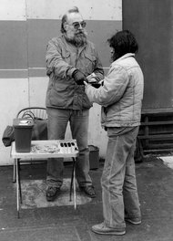
Syringe Access
Our Roots in Harm Reduction!
“How does this work?”
“You give me an old one, I give you a sterile one, and it keeps your butt alive”
Doug Wilson
Dave Purchase handing out syringes on his own in Tacoma, Wash., in the late 1980s. New York Times, January 27, 2013
Notes:
KEY MESSAGES
Harm reduction stems from syringe exchange.
Foto from the New York Times, featuring Dave Purchase handing out syringes on his own in Tacoma, Washington in the late 1980s.
“This is life and death. There were unnecessary deaths, unnecessary and preventable deaths.”
NOTES
Dave Purchase has been regarded as the Godfather of Syringe Exchange in the United States (1940~2013).
New York Times, January 27, 2013

Slide 21
Meeting Needs of PWID: Considerations
Higher prevalence of mental health issues
Higher prevalence of trauma
Poor social supports
Higher level of homelessness
Higher levels of incarceration & recidivism
Poor relationship with & access to healthcare system
Higher prevalence of other health issues

Slide 22
Drug User Health & HIV Prevention Issues
HIV/Hep C
Co-infection
Homelessness and Incarceration
HIV and Overdose
25-30% of HIV+ people are co-infected with Hep C.
Hep C is the leading cause of death for people with HIV.
Hep C infection can impact HIV treatment.
Sexual transmission of Hep C more likely for HIV+ persons.
40-90% of PWIDs have Hep C.
Overdose is a significant cause of mortality among HIV+ persons
HIV infection puts PWID at greater risk of fatal overdose.
Overdose prevention services can connect PWID to HIV prevention, care, and drug treatment services.
HIV prevalence is 3x higher in homeless population than the general population
1:7 people living with HIV will pass through a correctional facility each year.
People receiving HIV care in prison have difficulty accessing medications upon release.
(Open Society Foundations,: Why Overdose Matters, July 2010)
(CDC: HIV & Viral Hepatitis Fact Sheet, 2014)
(CDC: HIV in Correctional Settings, 2010)

Slide 23
Client-Centered AOD Treatment Issues
Abstinence-based treatment is not always an option.
Relapse is a part of the process.
People may not be ready to quit or may choose not to.
Providers can help to assess readiness and elicit change.
Motivational Interviewing is an approach to support people in making their own decisions regarding their own drug and alcohol use behaviors.
Notes:
KEY MESSAGES
Limited availability
On the part of the program, very difficult to find slots of low-income, homeless, etc.
Limited ability/convenience issues for people (work, childcare).
Undocumented or under/uninsured can’t access these programs, even if THEY WANT TO.
Harm Reduction
Menu of options, different models + approaches work for different people, based on WIDE RANGE of individual factors.
Motivational Interviewing
Great evidence-based counseling method to begin helping a clients to identify how/why/when/if to address AOD behavioral change, overcome ambivalence.
Encourage MI trainings
A great foundation for HR counseling and engagement. Recommended for all HR providers.
Abstinence-based drug treatment is not always a viable option.
Limited availability such as insurance coverage issues for undocumented or under/uninsured participants.
Research demonstrates relapse is a part of the process.
Often people may not be ready to quit or may choose not to, but we can help to assess readiness and elicit change.
Motivational Interviewing is an evidence-based counseling practice to support people in making their own treatment decisions and/or changing drug and alcohol use behaviors.

Slide 24
SAPs: Meeting People Where They Are
Started in Holland in the 1980s in response to a Hepatitis B outbreak.
One of the first U.S. SAP started in Tacoma in 1988 in response to the AIDS crisis.
Notes:
KEY MESSAGES
It’s important to note that these are programs that are born of activists’ response to a crisis.
The late 80s and early 90s were a very scary time in America.
People were disappearing because of AIDS.

Slide 25
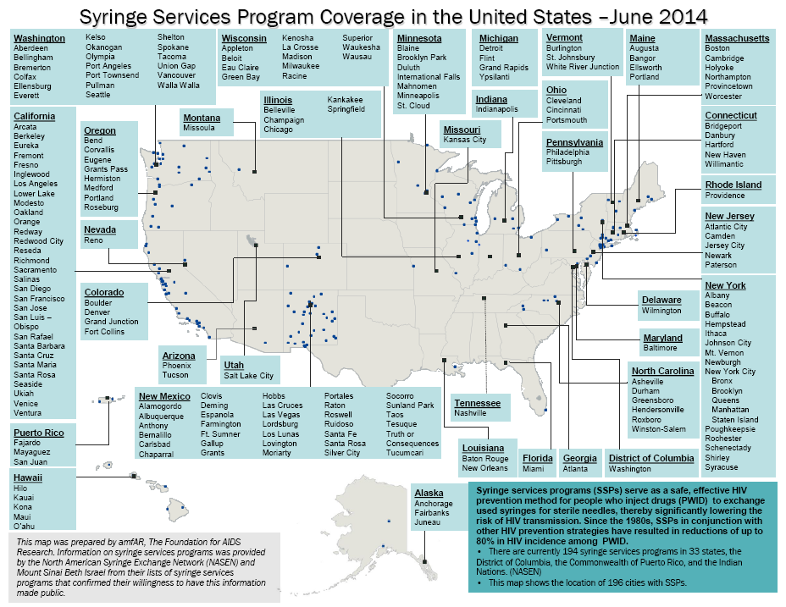
(amfAR, 2014)
Notes:
KEY MESSAGES
Does not show underground programs.
The red stars are new SAPs to be added.

Slide 26
Syringe Access Policies in U.S.
National HIV/AIDS Strategy (NHAS) 2020
Calls for minimizing HIV infection among PWIDs and other substance users.
Specifically sites syringe exchange as an intervention that will reduce the HIV infection rate among PWIDs.
National Hepatitis Plan 2011
Call to enhance PWID’ access to sterile syringes.
Updated April 2014
SAMHSA Opioid Overdose Toolkit 2014
Encourages expanding access to naloxone for people at risk for overdose and their friends and family.
Sources: https://www.aids.gov/federal-resources/national-hiv-aids-strategy/nhas-update.pdf
http://www.hhs.gov/ash/initiatives/hepatitis/actionplan_viralhepatitis2011.pdf http://store.samhsa.gov/shin/content/SMA13-4742/Overdose_Toolkit_2014_Jan.pdf

Slide 27
U.S. Surgeon Generals
Dr. David Satcher (1998-2002) Syringe exchange is “…an effective public health intervention that reduces the transmission of HIV and does not encourage the use of illegal drugs.”
Dr. Joyceln Elders (1993-1994) “Silence about the importance of needle exchange programs is causing deaths of thousands of our bright young black and Latino men and women.”
Dr. C. Everett Keep (1982-1989) “…if clean needles will do anything to contain a part of the epidemic, we should not have any foolish inhibitions about doing so.”
Notes:
NOTES
Syringe access is the most efficient method to prevent HIV among PWID and there is no question on the evidence-based intervention.
There is no controversy surrounding the science of syringe access, disposal, exchange, and distribution.
The controversies, or barriers, to syringe access are social.
It is our job to inform providers, policy makers, active drug users, and our communities the efficacy of syringe access.
27

Slide 28
3. Benefits of
Syringe Access Programs

Slide 29
Syringe Access Programs DO:
X Decrease spread of HIV
X Reduce risk for Hep C
X Increase likelihood to link PWID w. care

Slide 30
Syringe Access Programs DO NOT:
X Encourage drug use
X Increase inappropriately discarded syringes
X Increase needle stick injuries
Notes:
KEY MESSAGES
The science behind this stretches more than 30 years, and is overwhelming.

Slide 31
Reduction in HIV Incidence
Syringe access is the most effective, evidence-based HIV prevention tool for people who inject drugs.
Federal agencies for national health such as the CDC, SAMHSA, HRSA, and NIDA conclude the use of sterile syringes to prevent the spread of HIV and other blood-borne infectious diseases.
PWID have reversed the course of the AIDS epidemic by using sterile syringes and harm reduction practices.
Science-based Literature Review on SEPs in the United States 1996-2008. Joanna Berton Martinez
Notes:
KEY MESSAGES
Researchers say that this is the great success story of HIV Prevention.
The biggest successes we have managed to have in HIV transmission is with perinatal transmission and transmission among PWID.
Syringe access programs are the most effective, evidence-based HIV prevention tool for people who use drugs.
Seven federally funded research studies found that syringe exchange programs are a valuable resource.
In cities across the nation, PWID have reversed the course of the AIDS epidemic by using sterile syringes and harm reduction practices.
31

Slide 32
Reduction in Hep C Transmission Risk
Almost 1/3 of IDUs (31.8%) report sharing syringes and other equipment in U.S.*
Many participants of SEPs are referred to Hep B vaccination series and Hep C treatment.
Safer injecting equipment and education from an SEP assist IDU without Hep C to remain that way.
*HIV-Associated Behaviors among Injecting Drug Users—23 Cities, United States,
May 2005-Feb 2006;CDC MMWR; April 10, 2009; 58(13);329-333
Notes:
KEY MESSAGES
Syringe Access Programs (SAPs) can help reduce incidents of sharing through providing sterile equipment and supplies, safer injection education, exploring barriers for the individual, and increasing self-efficacy.
Historically, SAP focus was on HIV prevention, leaving many long-time injectors infected with chronic HCV – sometimes undetected for years. In the past decade+, HCV has been ‘on the map’ – if not, this percentage (31.8%) would be much higher. - More people now getting tested, treated, connected to care, and NOT SHARING syringes and equipment. MORE NOT SHARING THAN SHARING.
Last bullet: focus on new injectors, discuss testing & treatment as prevention.
NOTES
Source: HIV-Associated Behaviors among Injecting Drug Users—23 Cities, United States,
May 2005-Feb 2006;CDC MMWR; April 10, 2009; 58(13);329-333
Available at httlp://www.cdc.gov/mmwr/preview/mmwrhtml/mm5813a1.html
32

Slide 33
Reduction of Needle Stick Injuries
Building a connection with law enforcement!
30% of law enforcement officers have experienced a needle stick injury (NSI).
66% reduction in NSIs among law enforcement officers following the implementation of SAPs.
Sources: Lorenz J, et al.
Occupational Needlestick Injuries in a Metropolitan Police Force. American Journal of Preventative Medicine, 2000. 18:146-150.
Groseclose SL, et al. Impact of Increased Legal Access to Needles and Syringes on Practices of Injecting Drug Users and Police Officers—Connecticut 1992-1993; Journal of AIDS and Human Retrovirology; 10(1): 71-72.

Slide 34
More Than Syringes
Detox and drug treatment programs
Medical, dental & mental health services
Bad Date Sheet
Hep A + B Vaccinations
HIV/Hep C services
Housing services
Safer sex supplies & education
Overdose prevention
Prevention for non-injectors
Notes:
KEY MESSAGES
Syringes can be the “hook” to reach PWID and offer holistic care:
Referrals to detox, rehab, DV services, safer sex supplies, Hep A + B vaccinations
A Bad Date Sheet is a description of violent or abusive customers in the sex industry.
Programs pass around printed sheets from SAP as a measure of harm reduction for sex workers.

Slide 35
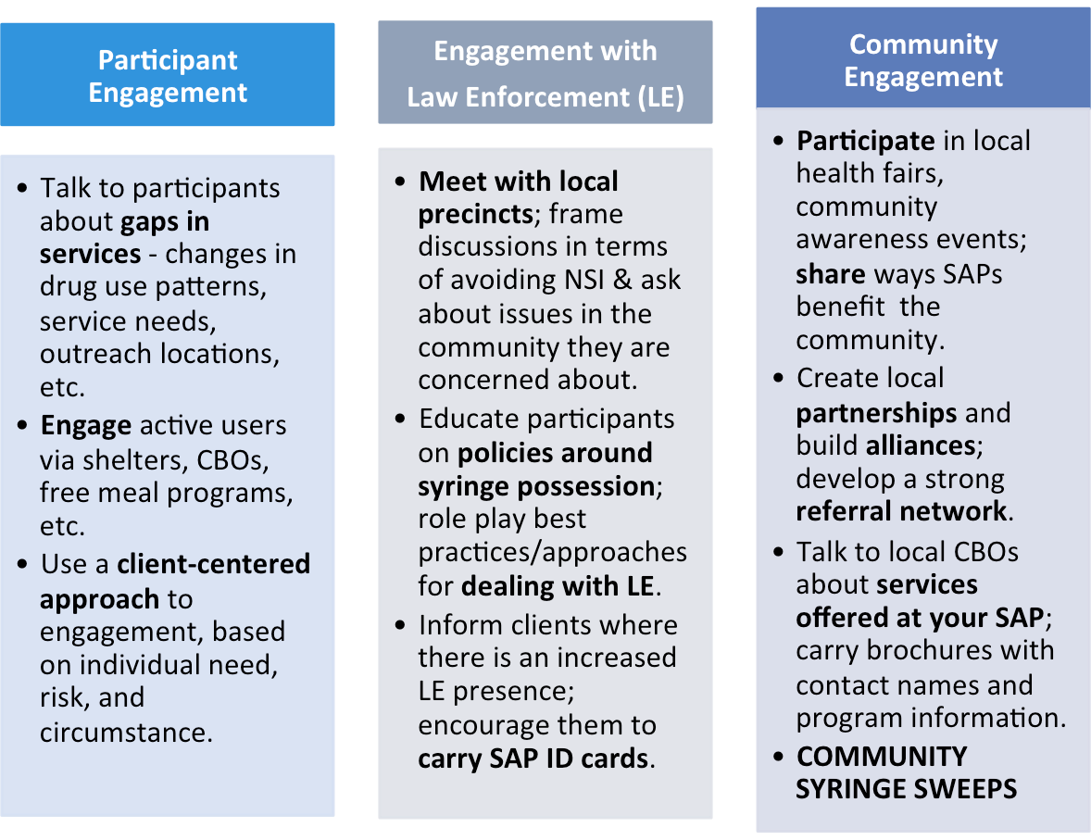
Outreach & Engagement
Notes:
NOTES
In terms of responses to these issues – e.g. “can also be a backdoor to syringe access and overdose prevention; the need to integrate SAS into the spectrum of services for PWUD. SAS can be a pathway to these services (and visa versa).

Slide 36
BREAK

Slide 37
ACTIVITY
4. Perspectives
Notes:
TRAINERS PREP
Hang on the wall prepared newsprint
There are 6-newsprints total
Hang in pairs so the perspective of Law Enforcement and PWID are together side by side
These pairs are coupled by: P (Positive), M (Minus), and I (Interesting)
ACTIVITY INSTRUCTIONS
Break into 3-4 small groups.
Supply each group with markers and a pair of labeled newsprint*
Go to the next slide and keep it up during the activity.
Optional
Facilitate large group discussion instead of small groups if time is short.
NOTES
This purpose of this activity is to illicit thoughts rather than debate the pros and cons.
Sometimes people have thoughts and ideas that are not positive or negative, so they are categorized as “interesting”.
These thoughts are often classed as “thinking outside the square” and can lead to a greater understanding and shifting perspective on many issues.

Slide 38
Activity
Law Enforcement Perspective | PWID’ Perspective
What might LE think of PWID? What are their professional & personal concerns about PWID? How do these perspectives affect the way law enforcement behaves when it deals with PWID? | What might PWID think of law enforcement? What are their personal concerns about law enforcement? How do these perspectives affect the way PWID behave when they deal with law enforcement?
Notes:
Keep this slide up during Activity
ACTIVITY INSTRUCTIONS Continued
Allow 3-5 minutes for the group to brainstorm EACH SECTION
The entire brainstorms would be 6-10 minutes total from perspective of LE and PWID.
Now ask groups to mark next to each thought a “P, M, or I”, whether they consider it “positive”, “minus/negative”, or “interesting”.
Have one representative from each group relay back to the larger group one example of a “P”, “M”, and “I”, briefly explaining why they marked this thought as such.
Afterwards, de-brief in a large group:
How do these perspectives affect the work we do? Allow for 5-7 minutes for large-group brainstorming/discussion.

Slide 39
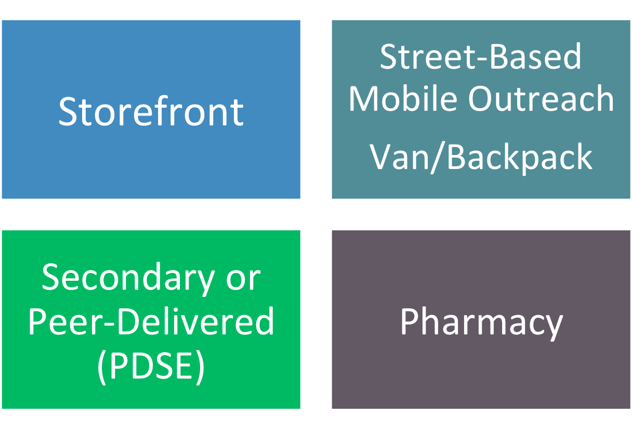
5. SAP Models & Interventions
Notes:
KEY MESSAGES
Storefront
Street-based
Secondary or peer-delivered
Underground programs
Pharmacy access
Optional
Delay slide and ask audience what they expect the pros/cons of model.

Slide 40
Storefront /Fixed Site
Benefits Challenges
House other services
Shelter from street-based activities
Increased privacy
On-site storage space
Creating “safe space”
Limited access
(hours, location)
Clients must come to you
High overhead and upkeep
Potential focus of community opposition

Slide 41
Street-Based
Benefits Challenges
Flexibility if drug scene changes
More acceptable to neighborhood
Informal, low-threshold
Meeting people where they are physically at
Hard to include ancillary services
Inclement weather can be a deterrent
Privacy concerns
Safety for outreach staff

Slide 42
Peer-Delivered
Benefits Challenges
Taps into peer knowledge
Can reach groups unlikely to access SAPs
Empowers peers to take ownership
Increased volume
Training & supervision needed for peers
Managing boundary issues
Peers may need to collect and transport others’ equipment

Slide 43
Pharmacy Access
Benefits Challenges
Mainstream location
May have more extended hours
Could be located closer to where PWID live or hang out
Pharmacists often refuse to sell syringes without a prescription
Cost can be prohibitive
No counseling services
Other injection equipment not available
No disposal options

Slide 44
Characteristics of Effective SAPs
Ensures low-threshold access to services.
Promotes secondary syringe distribution.
Coordinates linkages to health and social services.
Ensures PWID have a VOICE.
Includes diverse community stakeholders in creating a social and legal environment supportive of SAPs and PWID.
Includes participants in improving on existing services.
How can this be achieved in your area?
Recommended Best Practices for Effective Syringe Exchange Programs in the in the United States: 2009
Notes:
ASK
How can this be achieved in your area?

Slide 45
SEP Practices to Avoid
Supplying single use syringes
Limiting frequency of visits & number of syringes
Requiring one-for-one exchange
Imposing geographic limits
Restricting syringe volume with unnecessary maximums
Requiring identifying docs.
Requiring unnecessary data documentation
Notes:
ASK
Any concerns or challenges here?

Slide 46
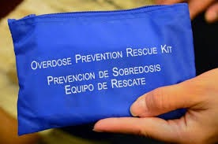
Basic Equipment

Slide 47
Basic Equipment
Syringes in various sizes
Cookers
Cottons/Filters
Tourniquets/Ties
Health education literature
Narcan kits
Sterile water
Alcohol swabs
Condoms, safer sex supplies
Gauze pads, bandages, abscess kits
Bleach kits
Fit Packs/Sharps Containers
Safer Smoking Kits/ ‘Crack Kits’
Notes:
ASK
What supplies and equipment can local programs offer PWID?
Are there supplies or equipment that is not allowed for the program to provide or because a law says so?

Slide 48
Best Practices
Handling Sharps & Hazardous Waste
Preventing needle-stick injury is everyone's responsibility, including staff, volunteers, & participants - EVERYBODY
Wear closed toe shoes
Know your agency’s accidental needle-stick protocols
Work in 2’s
Have latex or alternative gloves within reach
Tongs, paper towels, bleach/water spray bottle, too
Keep syringe disposal/access area clean & well-lit
Notes:
KEY MESSAGES
Preventing needle-stick injury is everyone's responsibility including staff, volunteers and clients!
Keep syringe access area clean and uncluttered (ex: no food or drink on the exchange table).
Wear appropriate clothing like closed toe shoes.
Inform every new worker* of the agency’s accidental needle-stick protocols.
Educate clients about carrying and disposing of syringes, safely.
Use puncture-resistant gloves for any handling of sharps containers.
Have latex or alternative barrier gloves, tongs, paper towels and bleach/water spray bottle within reach.
Ensure a well-lit syringe access area.
*paid or volunteer

Slide 49
Best Practices
Handling Sharps & Hazardous Waste
If you have to pick up a used syringe by the barrel always put on gloves first
Complete your 3-shot Hep B vaccination series
Always keep sharps container on a flat surface
Wash hands before + after each shift
Never insert hands or push fingers into sharps
Switch out container when 3/4 full
Secure sharps container + lid for travel
Notes:
KEY MESSAGES
If you have to pick up a used syringe by the barrel always put on gloves first.
Do not hold a sharps container when someone is disposing of their used syringes. Always place sharps container on a flat surface (ex: sidewalk, floor).
Never insert hands into the sharps containers or forcibly push injection equipment into container with your fingers.
Switch out sharps container when it’s 3/4 full.
If transporting, ensure the lid and entire sharps container are secure for travel.
Complete 3-shot Hepatitis B vaccination series.

Slide 50
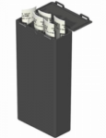
Best Practices
Handling Sharps & Hazardous Waste
Safety Tips for Clients
Re-cap syringes prior to returning
Transport used syringes in hard plastic container w. a lid
Ex: sharps container, fit pack, soda/detergent/bleach/milk bottle
At the program, participants dispose of their own syringes, not staff
Notes:
KEY MESSAGES
For Clients
Transport syringes in a hard plastic puncture-proof container (if no sharps container, try detergent or bleach bottle).
Re-cap syringes prior to returning (if no cap, use cigarette filter).
Clients are responsible for disposing of their syringes into sharps containers at the program, not staff.

Slide 51
Reflective Practice: Syringe Access
Identify
Which SAP Models would engage program participants most effectively? What are challenges you may encounter? What strategies could improve engagement?
Explain
Describe gaps in services that you’ve observed in your role at the agency, or from participant feedback.
Apply
What specifically do you feel you can do now to ensure effective engagement & service delivery?
Notes:
Refer to Worksheet
TRAINER INSTRUCTIONS
These are a few ideas to apply the day’s workshop into practice.
Encourage participants to share in supervision, with peers, and/or with colleagues at their agency.

Slide 52
6. Closing & Evaluations
Anonymous Surveys:
Put completed surveys in the folder
Notes:
Refer to Blank Evaluation Handout
TRAINERS INSTRUCTIONS
Ask participants to complete the anonymous survey.
Provide a large manila envelope or folder for participants to put their completed surveys.
Optional
Plus/Delta is a closing exercise where every person can give one example of what worked or was effective about the day’s workshop, and one suggestion that could improve the workshop.
Each person has a turn with the option to say “Pass.”
The purpose of this closing exercise is to give each participant a chance to share their opinion verbally if writing is not how they express themselves best.
Avoid having discussion on responses, this exercise is meant to move forward to wrap up the day.

Slide 53
HRC thanks you for participating in this workshop!

