Slide 1
stigma
attitudes toward those with substance use disorders and the impact on care
Christopher Abert

Slide 2
disclosures
Acknowledgment: This CME event is not supported by any commercial entity.
Disclosure: Alison Essary, DHSc, MHPE, PA-C discloses that she has received grant/research support from BCBS Mobilize AZ Grant Program and is a shareholder with Denali. Adrienne White, MS discloses that she has received grant/research support from BCBS Mobilize AZ Grant Program. All other speakers and members of the planning committee have no relevant financial relationships with a commercial interest to disclose.
Accreditation Statement: This activity has been planned and implemented in accordance with the accreditation requirements and policies of the Arizona Medical Association (ArMA) through the joint providership of HonorHealth and Arizona State University. HonorHealth is accredited by ArMA to provide continuing medical education for physicians.
Credit Statement: HonorHealth designates this live activity for a maximum of _1_ AMA PRA Category 1 Credits™. Physicians should only claim credit commensurate with the extent of their participation in the activity.
Funding Statement: This activity has been funded by research grants from SAMHSA and BC/BS Mobilize AZ initiative.

Slide 3
Instructor
Christopher Abert
Executive Director,
Southwest Recovery Alliance

Slide 4
objectives
describe history of criminalization
describe multiple theories about stigma
formulate responses to stigma
explain the consequences of stigma

Slide 5
how did we get here?

Slide 6
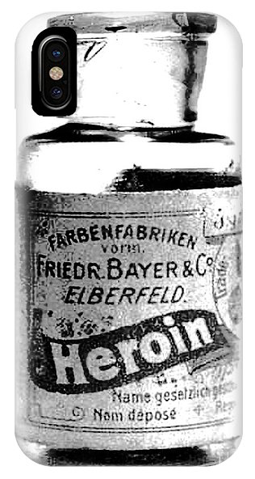
A brief history of racialized drug policy…
1880’s Chinese Exclusion Laws & Opium
1910’s Mexican Immigrants & Marijuana
1920’s African American Men & Cocaine
1960’s Nixon’s War on Drugs
1980’s Crack Epidemic
“The criminalization of drugs and the crafting of the issue into a moral dilemma built a society-wide aversion to drug users. From there, users were isolated and ignored under the guise that they couldn’t, and shouldn’t, be helped.”
--Dr. Greg Scott, DePaul University
Notes:
Lots to get into, but these examples are useful in understanding how stigma, and thereby health risk, was created through a social and legal process in the US.
Historically, drug policy has been created to criminalized communities of color, and singled out certain types of drugs for punishment. Chinese with opium, Mexican immigrants with marijuana, and most recently it culminated with Af Am and crack epidemic of the 80’s-90’s. It’s important to understand that we have been exposed to over 150 years of negative messaging, specifically about people of color who use drugs, with over a trillion dollars disseminating that message. They are dangerous, they are bad, they deserve whatever consequences come their way, and they need to be kept away from “us.”
Dr. Greg Scott, an expert on SUD and stigma from DePaul University summed it up when he said “The criminalization of drugs and the crafting of the issue into a moral dilemma built a society-wide aversion to drug users. From there, users were isolated and ignored under the guise that they couldn’t, and shouldn’t, be helped.“
The intentional vilification of people who use drugs is exemplified with this statement from Nixon’s Domestic Advisor, John Erlichman.
Provine, D. M. (2007). Unequal under law: Race in the war on drugs. Chicago, IL: Chicago University Press.
http://www.kcba.org/druglaw/pdf/report_hc.pdf
Hickman, 2000
Musto, 1999
Lassiter, 2015

Slide 7
criminalization
“… by getting the public to associate the hippies with marijuana and blacks with heroin. And then criminalizing both heavily, we could disrupt those communities…We could arrest their leaders, raid their homes, break up their meetings, and vilify them night after night on the evening news. Did we know we were lying about the drugs? Of course we did."
John Erlichman, Nixon Senior Policy Advisor
Notes:
https://harpers.org/archive/2016/04/legalize-it-all/

Slide 8
thoughts on stigma existential AND achieved
Notes:
Now for some thoughts on stigma
Gerard Falk distinguished between existential stigma and achieved stigma.
Existential stigma is spurred by conditions such as mental illness, over which the target has little or no control
Achieved stigma is perceived as earned by the subject's own actions, such as criminal behaviors
SUD is a very complicated mix of both.
Nora Volkow, the director of the National Institute on Drug Abuse, recently authored a paper about this complicated mix of stigma. Interestingly, her agency uses the stigmatizing word “Abuse” in its title, implying that people who use drugs are “abusers,” Research has suggested that using the word “abuse” leads to negative outcomes for people who use drugs. We know that stigma changes over time, and often times our language doesn’t change fast enough to keep up.
Falk, Gerhard How We Treat Outsiders
https://www.ncbi.nlm.nih.gov/pubmed/20005692

Slide 9
COURTESY
STIGMA
Provider/Patient Parent/Child
INTERVENTION
STIGMA
Notes:
Another type stigma we are exposed to is what is refered to as “Courtesy Stigma”:
An example of this is when we refer to baby being born “addicted”, or
That parents must have done something wrong if child overdoses, or that
providers associated with people who use drugs are no better than street level drug dealers. This is something you will have to face.
It’s also important to understand the research around Intervention Stigma, which can be wholly separate from stigma specifically aimed at people with OUD. One example is when people in 12 step recovery, who harbor little stigma towards people with OUD, nonetheless have stigmatizing views toward MAT. Or pharmacists who refuse to fill prescriptions.
Some of the drivers of intervention stigma associated with MAT are
stringent federal regulations (methadone)
using personal addiction treatment experiences to guide professional practice (12 step counselors)
limited knowledge of MAT science, almost no education on harm reduction
Triple threat of mental disorder, SUD and criminal record
https://www.ncbi.nlm.nih.gov/pubmed/31125801 Heatherton, Kleck, Hebl & Hull, The Social Psychology of Stigma, The Guilford Press, 2000.
Erving Goffman Stigma: Notes on the Management of Spoiled Identity,

Slide 10
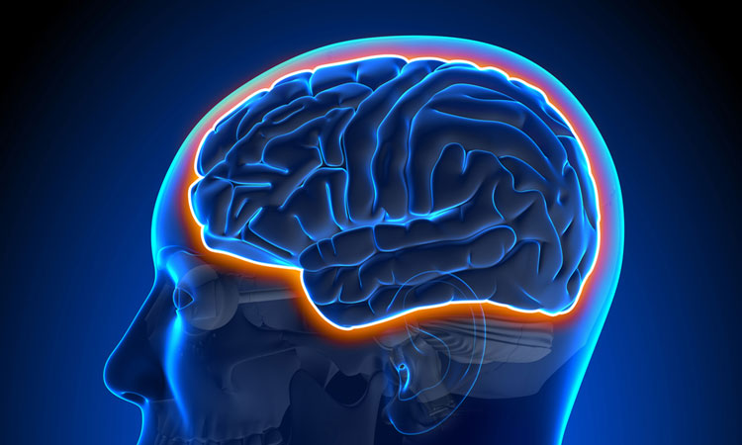
blaming the individual
Disease Model (Genes/Neurological Disorder)
there is something wrong with you
Rational Actor Model (Behavior)
you make bad choices, stop it
stay tuned:
Biopsychosocial
Model
Notes:
It also doesn’t help that two of the primary lenses through which society views addiction leave the individual culpable for either haivng a physiological deficiency or moral deficiency
Luckily, we can have robust literature on an alternative to these, the biopsychosocial model, that we will discuss in a future didactic. Stay Tuned!
equal importance to biological/genetic, psychological, and sociocultural factors
biological, genetic, personality, psychological, cognitive, social, cultural, and environmental factors interact to produce the substance use disorder, and multiple factors must be addressed in prevention and treatment programs
https://is.muni.cz/el/1423/jaro2018/PSY109/um/68207459/Biopsychosocial_Model_of_Addiction_Miller_P__2013__
Allows many treatment options even if patient is not willing/able to abstain

Slide 11
complicated
individualized tx
challenging
Notes:
The point of all this is to illustrate that SUD stigma is complicated, SUD causes are complicated, SUD tx can be complicated. But OUD tx is actually not all that complicated.
There is no “one size fits all” tx plan, but MAT is gold standard for OUD
Challenging for providers AND patients due to stigma/criminalization
(https://www.youtube.com/watch?v=572N_5obPBI&feature=emb_logo&fbclid=IwAR0Nk0-6Zf2u4wZxQ_3uT5rCqTfa9rAgsA5-bdEY9pAvyl8k6pBMurwjHrA)

Slide 12
thoughts on what to do

Slide 13
meeting people “where they’re at”
celebrate small positive changes
treat patients as individuals
value their unique experiences and needs
see patients as more than their drug use
recognize vulnerability of their being honest
utilize motivational interviewing and transtheoretical model (“stages of change”)
Notes:
There are lots of ways we can meet people “where they’re at.”
One of them is recognizing when patients make small positive changes, such as switching from injecting to smoking. We can celebrate these changes and encourage more. These can often serve as a toehold for future changes, and can lead to significant positive health outcomes in and of themselves.
treat patients as individuals
value their unique experiences and needs
see patients as more than just their drug us
recognize the vulnerability of their being honest, which we will discuss later
utilize motivational interviewing/TTModel of change
Why use TTModel of Change?
35 years of scientific research, 80 million dollars and 150,000 research participants have produced the dominant theoretical model of behavioral change
It suggests that internal motivation is the key to long term behavioral change. We can, and should, utilize this evidence based approach to foster lasting positive change in our patient’s lives
https://www.apa.org/education/ce/motivation-autonomy.pdf

Slide 14
organizational changes
increase staff cultural competency through training and education, harm reduction
extend training to ALL staff -- anyone who interacts with patients should receive training (front desk, custodial, security)
provide opportunities for patient feedback
audit agency materials for language
Notes:
Some of the organizational changes we can make are to:
increase staff cultural competency through training and education, harm reduction
extend training to ALL staff -- anyone who interacts with patients should receive training (front desk, custodial, security)
provide opportunities for patient feedback
audit agency materials for language
https://www.ncbi.nlm.nih.gov/pmc/articles/PMC3272222/

Slide 15
person first language
Words to avoid | Words to use
Addict | Person with substance use disorder
Alcoholic | Person with alcohol use disorder
Drug problem, habit | Substance use disorder
Drug abuse | Drug misuse, harmful use
Drug abuser | Person with SUD
Clean | Abstinent, not actively using
Dirty | Actively using
A clean drug screen | Testing negative for substance use
A dirty drug screen | Testing positive for substance use
Former/reformed addict/alcoholic | Person in recovery, person in long-term recovery
opioid replacement, methadone maintenance | medication-assisted treatment
Notes:
I won’t go through all of these, but it is important we give thought to the words we use. If you want something to thrivee, call it a flower. If you want it to die, call it a weed.
Research I mentioned earlier suggested that mental health and addiction clinicians were more likely to favor a jail sentence over treatment when a character in a case vignette was described as a "substance abuser" than when that character was described as having a "substance use disorder.“
Clean/dirty (implies people who use drugs are dirty)
Opioid Replacement vs. Medication Assisted Treatment
People who use drugs are also commonly thought of as liars (NEXT SLIDE)
http://jod.sagepub.com/content/40/4/805.refs.html
https://www.ncbi.nlm.nih.gov/pubmed/20005692

Slide 16
why won’t they be honest?
Notes:
One of the most common challenges I hear from providers is that their SUD patients won’t be honest with them. People who use drugs are commonly referred to dishonest and untrustworthy.
I want to challenge this notion by suggesting that people who use drugs aren’t inherently dishonest, but they ARE constantly put in positions where they feel; they have to lie to protect themselves. Why?

Slide 17
{
incarceration
unemployment
department of child services
loss of benefits
loss of housing
red flagged
the
vulnerability
of disclosure
Notes:
Because there is vulnerability in being honest.
Consequences of being honest about drug use are
incarceration
unemployment
department of child services
loss of benefits
loss of housing
red flagged on medical records

Slide 18
voting rights
volunteer opportunities
employment
respect
participating in family events
stigma leads to losing…
autonomy
social ties
housing
education
jury duty
therapy
medications
Notes:
There are so many consequences people who use drugs risk when being honest
Some professionals won’t be honest because they don’t want to be associated with “addicts”
The list goes on and on, but can be summed up as:

Slide 19
permanent
second class
citizenship
Notes:
The consequences are tangible, and every time a person is honest with us about their drug use, we should recognize what they’re risking, and honor the relationship. We can do that by continuing to offer (NEXT SLIDE)
https://www.ncbi.nlm.nih.gov/pmc/articles/PMC3682466/

Slide 20
respect and sympathy dignity and compassion relying on the data mat = positive change
Notes:
Respect for the patient, particularly the resilience they must have had to make it this far
We can extend Sympathy for the underlying causes of chaotic drug use and having to navigate a system designed to fail them
We can offer Dignity patients deserve as they struggle towards making positive changes in their lives, no matter how small
We can be compassionate for SUD being one of the only conditions that leaves people alone and ashamed.
We can rely on they fact that the data is on our side, never forget we have the charts and graphs, and we are on the right side of history.
We can know that the positive changes brought from MAT include avoiding HIV and HCV, maintaining employment, avoiding the carceral system, reduction of illicit use, increased tx adherence, and most importantly reduced fatal overdose. Again, data and history are on our side, and through perseverance this stigmatized condition, like other stigmatized conditions before it, will eventually change. We get to be part of the effort to change it.
https://www.pewtrusts.org/en/research-and-analysis/fact-sheets/2016/11/medication-assisted-treatment-improves-outcomes-for-patients-with-opioid-use-disorder
https://jamanetwork.com/journals/jamanetworkopen/fullarticle/2760032?fbclid=IwAR3A0XjUvmU_4LE3FZxnzwA_w85XDbSmQ8OXnKD0IwaIlPTXLQskbgk-YsY

Slide 21
references
Addictionary - Glossary of Substance Use Disorder Terminology. (n.d.). Retrieved February 11, 2020, from https://www.recoveryanswers.org/addiction-ary/
Associated Press Stylebook. (2020). Associated Press Stylebook. Retrieved from https://www.apstylebook.com/
Boekel, L. C. V., Brouwers, E. P., Weeghel, J. V., & Garretsen, H. F. (2013). Stigma among health professionals towards patients with substance use disorders and its consequences for healthcare delivery: Systematic review. Drug and Alcohol Dependence, 131(1-2), 23–35. doi: 10.1016/j.drugalcdep.2013.02.018
Botticelli, M. P. White House, White House (2017). Retrieved from https://www.whitehouse.gov/sites/whitehouse.gov/files/images/Memo - Changing Federal Terminology Regrading Substance Use and Substance Use Disorders.pdf
Broyles, L. M., Binswanger, I. A., Jenkins, J. A., Finnell, D. S., Faseru, B., Cavaiola, A., … Gordon, A. J. (2014). Confronting Inadvertent Stigma and Pejorative Language in Addiction Scholarship: A Recognition and Response. Substance Abuse, 35(3), 217–221. doi: 10.1080/08897077.2014.930372
Kelly, J. F., Wakeman, S. E., & Saitz, R. (2015). Stop Talking ‘Dirty’: Clinicians, Language, and Quality of Care for the Leading Cause of Preventable Death in the United States. The American Journal of Medicine, 128(1), 8–9. doi: 10.1016/j.amjmed.2014.07.043

Slide 22
references
Kelly, J. F., Wakeman, S. E., & Saitz, R. (2015). Stop Talking ‘Dirty’: Clinicians, Language, and Quality of Care for the Leading Cause of Preventable Death in the United States. The American Journal of Medicine, 128(1), 8–9. doi: 10.1016/j.amjmed.2014.07.043
Kelly, J. F., Wakeman, S. E. (2016) Language, Substance Use Disorders, and Policy: The Need to Reach Consensus on an “Addiction-ary”, Alcoholism Treatment Quarterly, 34:1, 116-123, DOI: 10.1080/07347324.2016.1113103
International Society of Addiction Journal Editors. (2015). Addiction Terminology. Retrieved from https://www.isaje.net/addiction-terminology.html
Livingston, J. D., Milne, T., Fang, M. L., & Amari, E. (2011). The effectiveness of interventions for reducing stigma related to substance use disorders: a systematic review. Addiction, 107(1), 39–50. doi: 10.1111/j.1360-0443.2011.03601.x
Recovery Research Institute. (n.d.). The Real Stigma of Substance Use Disorders. Retrieved from https://www.recoveryanswers.org/research-post/the-real-stigma-of-substance-use-disorders/
SAMHSA's Center for the Application of Prevention Technologies. (November, 2017), from https://www.samhsa.gov/capt/sites/default/files/resources/sud-stigma-tool.pdf
The National Academies Press. (2016). Ending discrimination against people with mental and substance use disorders: the evidence for stigma change. Washington, DC. (https://www.nap.edu/catalog/23442/ending-discrimination-against-people-with-mental-and-substance-use-disorders)

Slide 23
Thank you!
Christopher Abert
Executive Director, Southwest Recovery Alliance
812-320-7525
cabert@southwestrecoveryalliance.org

